Slide 1

Lifestyle Website PENETRATION TESTING

Slide 2
Security Status – Extremely Vulnerable
Hacker can steal all records in Internshala databases
Hacker can take control of complete server including View, Add, Edit, Delete files and folders
Hacker can change source code of application to host malware
Server side and Client side filters not configured properly
User data is not secured properly and can be breadched
Authentication and Authorization issues

Slide 3
Vulnerability Statistics
CRITICAL
11
SEVERE
9
Moderate
4
LOW
6

Slide 4
VULNERABILITIES:
No | SEVERITY | VULNERABILITIES | COUNT
1 | Critical | SQL INJECTION | 3
2 | Severe | REFLECTED AND STORED XSS | 2
3 | Severe | IDOR | 3
4 | Critical | Rate Limiting Issues | 1
5 | Critical | Insecure File Uploads | 1
6 | Moderate | Client side Filter Bypass | 1
7 | Critical | Components with known vulnerabilities | 3
8 | Critical | Default Admin Password | 1
9 | Low | Descriptive Message | 1
10 | Low | Default Files and Pages | 5

Slide 5
Vulnerabilities:
11 | Critical | Local File Inclusion | 1
12 | Moderate | Directory Listing | 2
13 | Moderate | PII leakage | 1
14 | Severe | Open Redirection | 1
15 | Severe | Bruteforce Coupon Codes | 1
16 | Severe | Forced Browsing | 2
17 | Critical | Seller Account Access | 1

Slide 6
1)SQL INJECTION
Below mentioned URL in the online e-commerce portal is vulnerable to SQL
injection attack
Affected URL :
http://13.235.100.207/products.php?cat=1
Affected Parameters :
cat (GET parameter)
Payload:
cat=1’

Slide 7
SQLi
Here are other similar SQLi in the application
Affected URL :
http://13.234.115.86/products.php?cat=2
http://13.234.115.86/products.php?cat=3

Slide 8
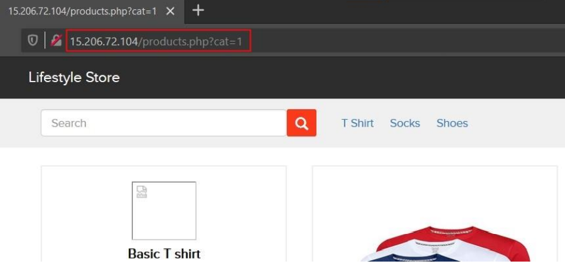
OBSERVATION:
Navigate to the Main Page of the website where you will see categories option click on “T Shirt” or “Socks” or “Shoes” to get into this URL, you will see products as per the category you have chosen but notice the GET parameter in the URL

Slide 9

Observation
Now, we apply single quote in category parameter(i.e. GET parameter): 15.206.72.104/products.php?cat=1’ and we get complete MySQL error

Slide 10
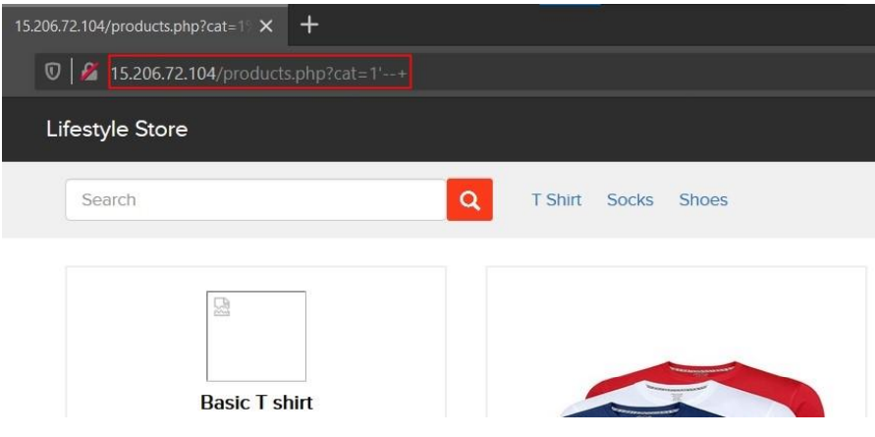
Observation
We then put --+ : 15.206.72.104/products.php?cat=1’--+ and the error is removed confirming SQLi

Slide 11
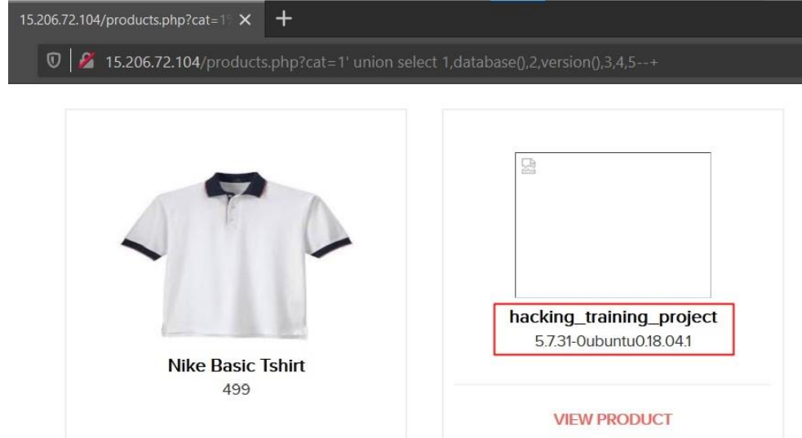
POC
Executing payload in afftected URL
http://15.206.72.104/products.php?cat=1’ union select 1,database(),2,version(),3,4,5--+

Slide 12
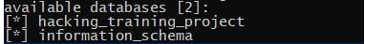
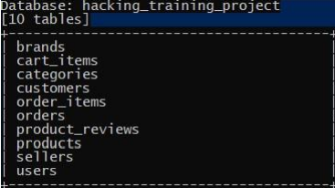
POC

Slide 13
Business Impact Extremely HIGH
Using this vulnerability, attacker can execute arbitrary SQL commands on Lifestyle store server and gain complete access to internal databases along with all customer data inside it.
Attacker can use this information to login to admin panels and gain complete admin level access to the website which could le ad to complete compromise of the server and all other servers connected to it

Slide 14
Recommendation
Take the following precautions to avoid exploitation of SQL injections:
If you are taking input that requires you to accept special characters, encode it. Example. Convert all ‘ to \’ , “ to \” , \ to \\. It is also suggested to follow a standard encoding for all special characters such has HTML encoding, URL encoding etc
Do not run Database Service as admin/root user
Disable/remove default accounts, passwords and databases
Assign each Database user only the required permissions and not all permission

Slide 15
Refrences
https://www.owasp.org/index.php/SQL_Injection

Slide 16
2)Reflected XSS
Below mentioned parameters are vulnerable to reflected XSS,
Affected URL :
• http://3.6.40.63/search/search.php?q=(here)
Affected Parameters :
• q
Payload:
• “><script>alert(1)</script>

Slide 17
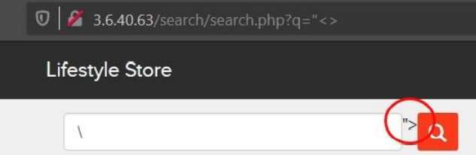
Observation
• Log in to your account.
• Then go to My Cart and then click on SHOP NOW button and type “<> in the Search Box.
• You will notice that the code being reflected on the website

Slide 18
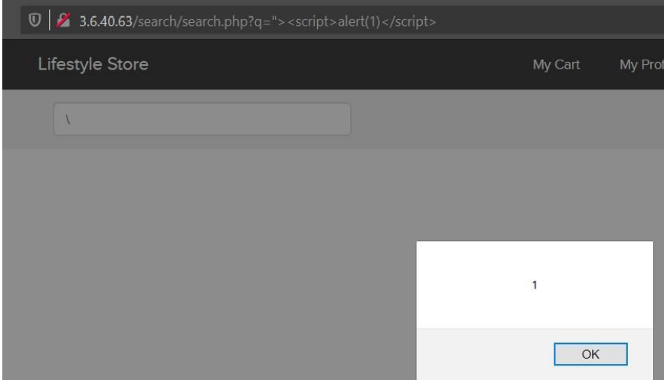
POC
• Now, put the payload instead of “<> after the q parameter: “><script>alert(1)</script>

Slide 19
2)STORED XSS
Below mentioned parameters are vulnerable to stored XSS,
Affected URL :
• http://13.232.162.26/products/details.php?p_id=(all id’s)
Affected Parameters :
• customer review text field
Payload:
• <script>alert(1)</script>

Slide 20
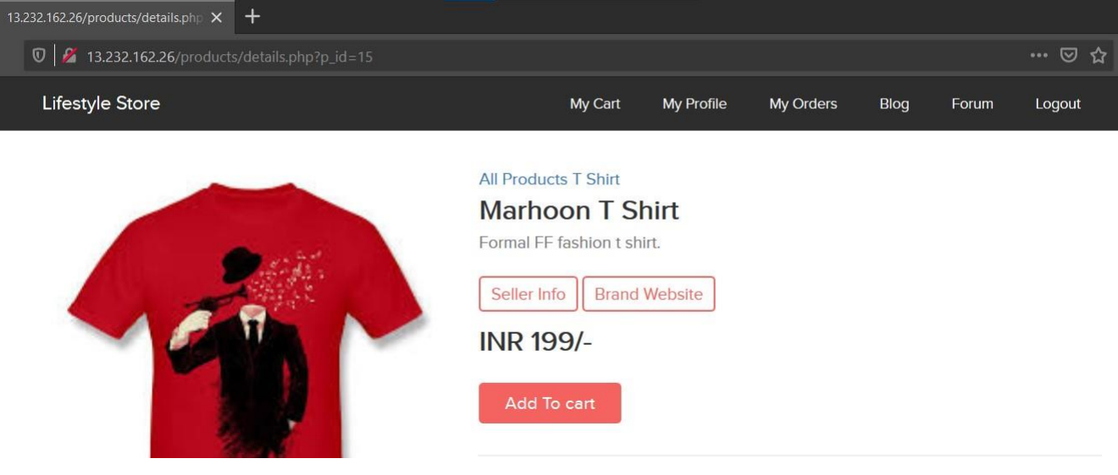
Observation
Navigate to http://13.232.162.26/products/details.php?p_id=15 (here I selected product number 15)

Slide 21
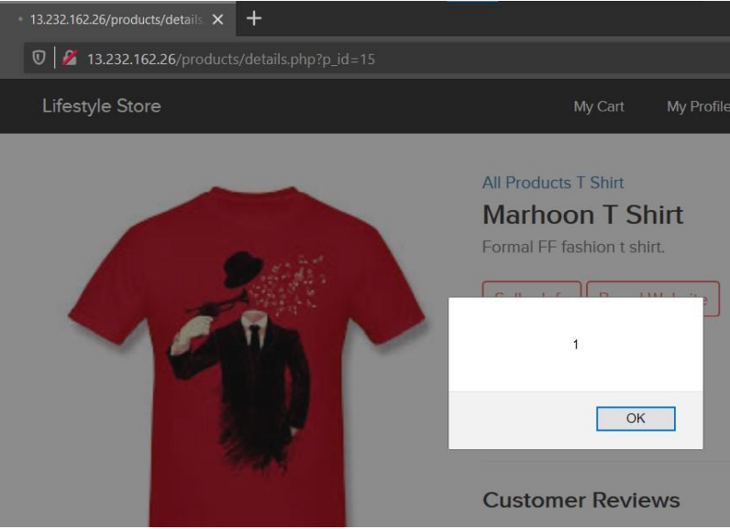
POC
Put the payload as a customer review in the review field: <script>alert(1)</script>

Slide 22
BUSINESS IMPACT HIGH
All the attacker needs to do is to type in the malicious script in the review field and then anyone opening the link can be attacked by the hacker and victim would see hacker controlled content on the website. As the user trusts the website, he/she will trust the content too.

Slide 23
Recommendation
• Sanitize all user input and block characters you do not want.
• Convert special HTML characters like ‘ “ < > into HTML entities &quot; %22 &lt; &gt; before printing them on the website

Slide 24
Refrences
https://owasp.org/www-community/attacks/xss/

Slide 25
3) IDOR
The My Orders section of the website suffers from an Insecure Direct Object
Affected URL :
• http://13.127.165.218/orders/orders.php?customer=(all customer id’s)
Affected Parameters :
• customer (GET parameters)

Slide 26
3)IDOR
Similar issue is found on below modules too,
Affected URL :
• http://13.127.165.218/products/details.php?p_id=(all id’s)
• http://3.6.40.63/forum/index.php?u=/user/profile/(any id)
Affected Parameters :
• p_id (GET parameters)
• u=/user/profile/(any id)

Slide 27
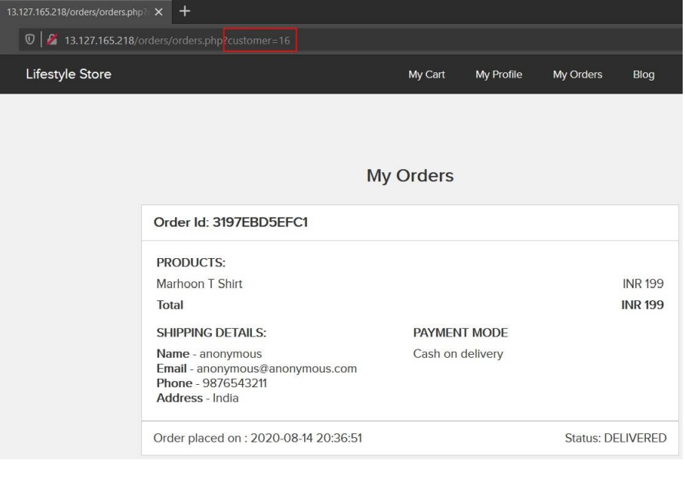
Observation
• Login to your account and go to My
Orders section.
• Your My Orders section will be shown
to you.
• Notice the URL :
http://13.127.165.218/orders/orders.ph
p?customer=16
• It contains customer id of the user and
we get the order details along with
shipping details and payment mode of
our user

Slide 28
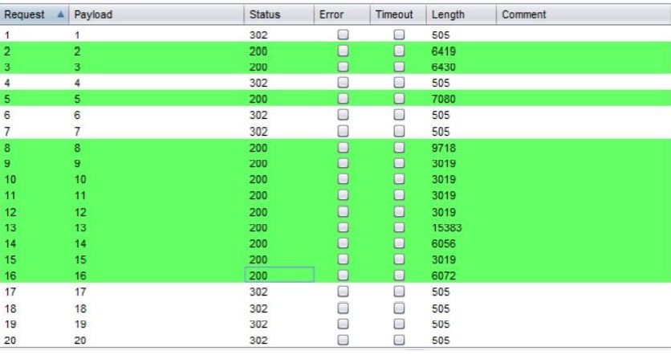
OBSERVATION
Since, the customer id is clearly visible, let’s intercept the request and brute force the customer id’s of all available customers.

Slide 29
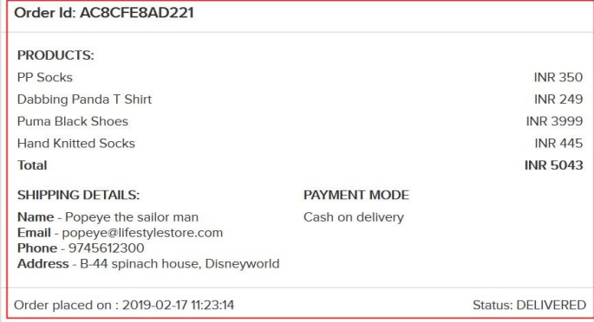
POC
ACESSING OTHER USERS ACCOUNT BI CHANGING ID
Now, we change the customer id to 5.
We get the order details along with
shipping details and payment mode of
other customers(here the user with
customer id = 5).

Slide 30
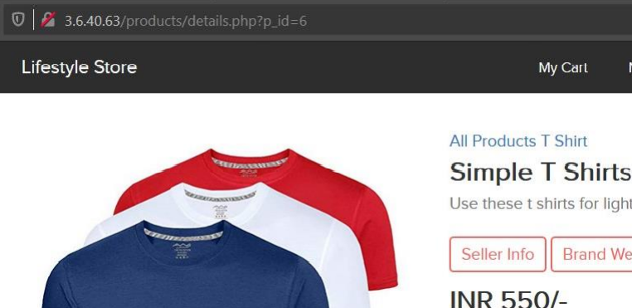
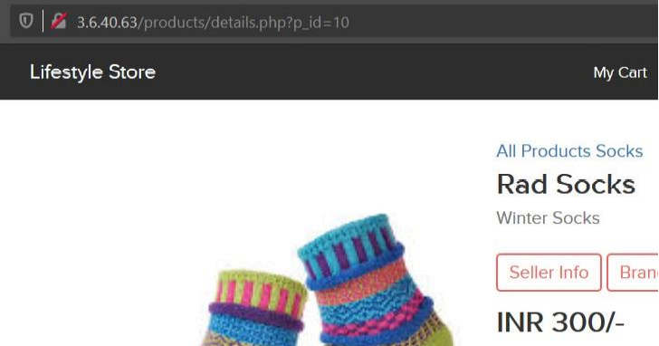
POC

Slide 31
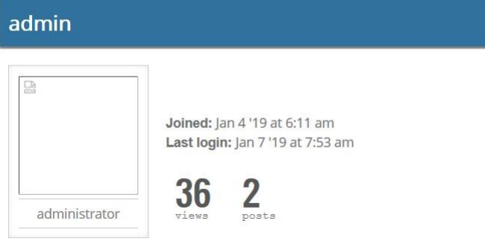
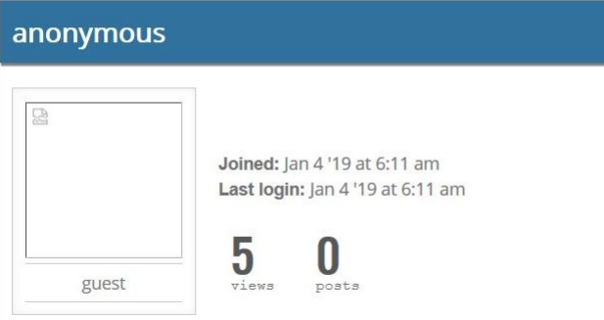
POC

Slide 32
Business Imapct- VERY HIGH
This discloses critical
order information of users including:
▪ Name
▪ Mobile Number
▪ Email Address
▪ Physical Address
▪ Order Id
▪ Bill Amount and Breakdown
▪ Payment Mode

Slide 33
Business Impact- Very High
• More over, as there is no rate limiting checks, attacker can brute force the customer id for all possible values and get
bill information of each and every user of the organization resulting is a massive information leakage.
• As a PoC, order details of few users are dumped in the folder named “customer order details”

Slide 34
Recommendation
• Make sure each user can only see his/her data only.
• Use proper rate limiting checks on the number of request comes from a single user in a small
amount of time.
• Implement proper authentication and authorization checks to make sure that the user has
permission to the data he/she is requesting

Slide 35
Refrences
https://owasp.org/index.php/Insecure_Configuration_Management

Slide 36
RATE LIMITING ISSUES
The below mentioned login page allows login via OTP which can be brute forced,
Affected URL :
• http://13.127.150.195/login/admin.php
Affected Parameters :
• otp (POST parameters)

Slide 37
OBSERVATION
• Navigate to http://13.127.150.195/login/admin.php, you will see a “Forgot your password?”
hyperlink which asks for OTP which is sent to admin’s phone number, write any 3-digit number (i.e.
any number from 100 - 999) and Intercept the request with Burp Suite.

Slide 38
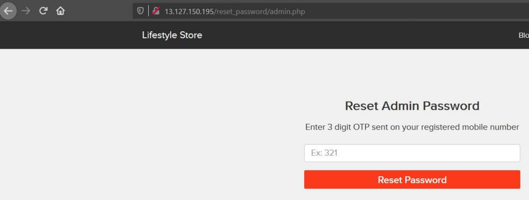
Observation

Slide 39
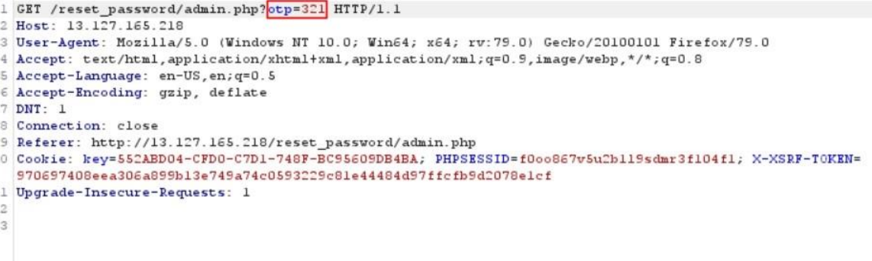
Observation
Following request will be generated containing OTP parameter(GET).

Slide 40
Observation
• We shoot the request with all possible combinations of 3 Digit OTPs and upon a successful hit, we get a response containing user details(i.e.the correct OTP). We can use this OTP to reset admin password and then use the new admin password to login as administrator.
• OTP for this Session was 760.

Slide 41
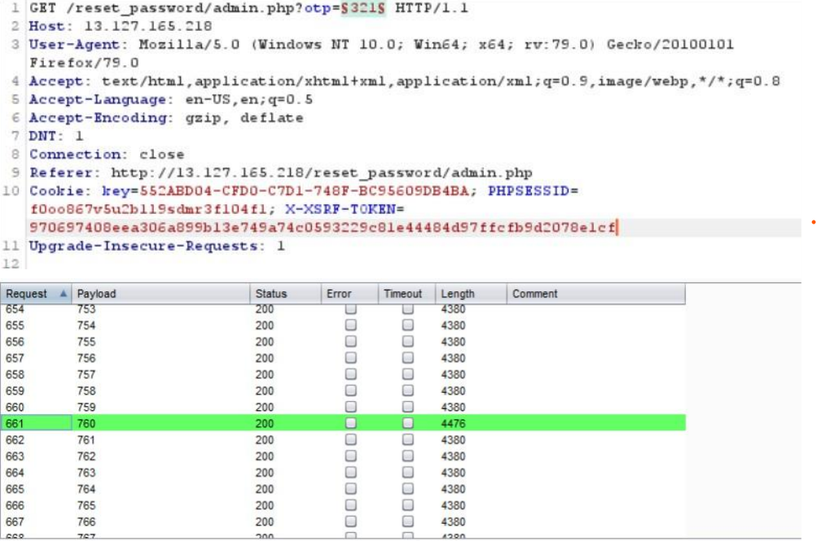
Observation

Slide 42
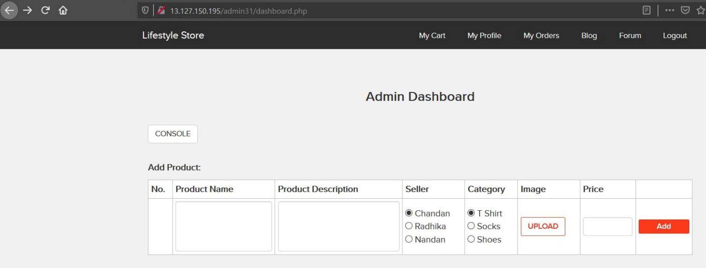
POC

Slide 43
Business Impact-Very High
A hacker can access admin panel by brute forcing due to rate limiting flaws .
It can lead to complete compromise of personal user data of every customer.

Slide 44
RECOMMENDATION
• Use proper rate-limiting checks on the no of OTP checking and Generation requests.
• Implement measures such as ReCAPTCHA after multiple incorrect attempts.

Slide 45
Refrences
https://owasp.org/www-community/controls/Blocking_Brute_Force_Attacks

Slide 46
5) INSECURE FILE UPLOADS
Below mentioned URL is vulnerable to insecure file uploads,
Affected URL :
• http://52.66.88.120/wondercms/
File Uploaded :
• backdoor shell (anonymous.php)

Slide 47
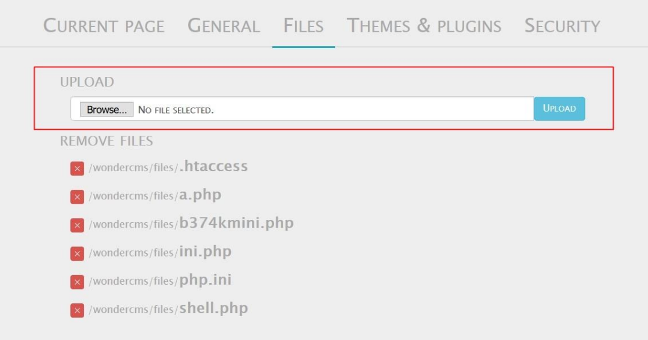
Observation
• Navigate to the Blog section of the website and login as admin.
• Now, navigate to the Settings and then go to Files option.
• You will notice an Upload section here,

Slide 48
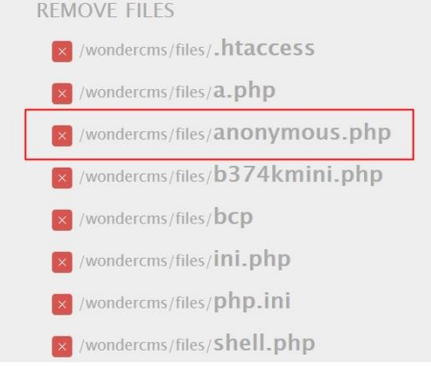
Observation
We are able to upload anonymous.php file

Slide 49
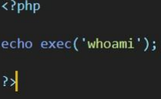
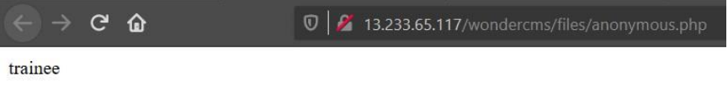
POC
Any command can be executed

Slide 50
Business Impact – Extremely High
Hacker can upload any kind of file with malicious intent
And upload malwares and backdoors

Slide 51
Recommendation
• Never accept a filename and its extension directly without having a whitelist filter.

Slide 52
Refrences
https://owasp.org/www-community/vulnerabilities/Unrestricted_File_Upload

Slide 53
6)Client side filter bypass
Below mentioned URL is vulnerable to client side filter bypass.
Affected URL :
• http://3.6.40.63/profile/16/edit/

Slide 54
Observation
• Login to your account and go to My Profile section.
• Now, click on edit profile button, update any of your details, here I will go with phone number only.
• I updated my phone number from 9876543211 to 9999999999.
• Now, again click on UPDATE button and intercept the request with Burp Suite.

Slide 55
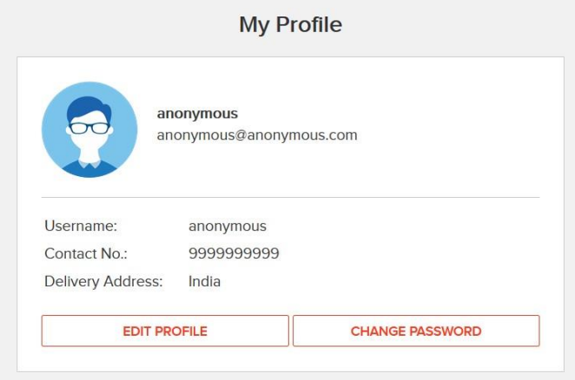
Observation

Slide 56
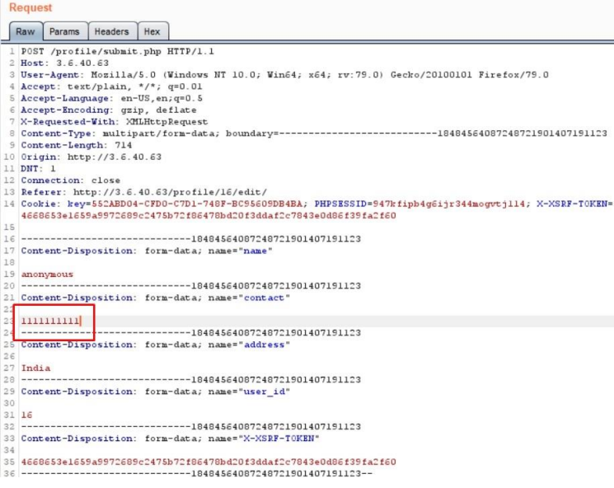
Observation
• Now, send the request to the Repeater and edit the phone number.
• I changed it from 9999999999 to 1111111111 and hit Send

Slide 57
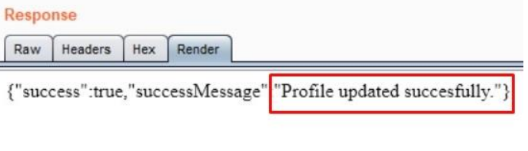
Observation

Slide 58
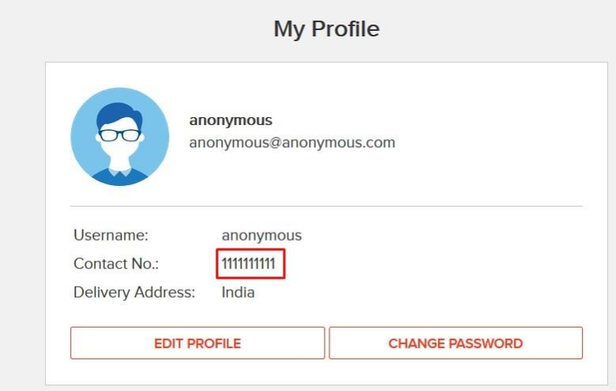
POC

Slide 59
Recommendation
• Implement all critical checks on server side code only.
• Client-side checks must be treated as decorative only.
• All business logic must be implemented and checked on the server code.

Slide 60
Refrences
https://portswigger.net/support/using-burp-to-bypass-client-side-javascript-validation

Slide 61
7)Components with known vulnerability
Below mentioned URL contains components with known vulnerabilities.
Affected URL:
• http://15.206.159.87/wondercms/
• http://15.206.159.87/forum/
and the PHP Version

Slide 62
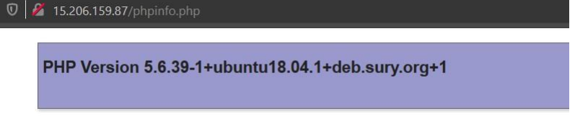
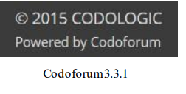
Observation
The php version of this website is 5.6.39-1 which is Out Dated.
CODOFORUM is also outdated

Slide 63
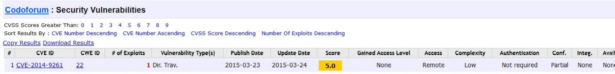
POC Codoforum has public exploits

Slide 64
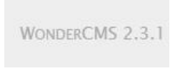
POC – WonderCMS is outdated and has public exploits

Slide 65
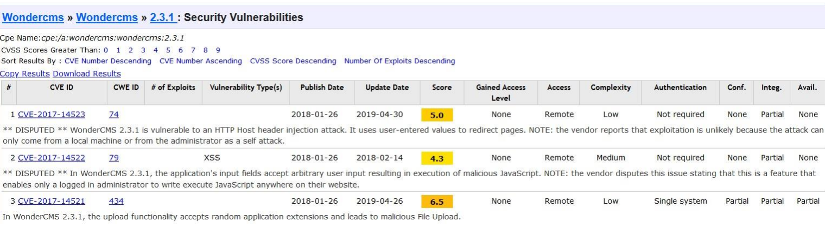
POC

Slide 66
Business Impact-Very High
• Anyone can perform any attacks (available) as all the exploits are available publicly .
• It can cause severe damage to the website
• He may be able to upload backdoor shells
• He will easily deface your website

Slide 67
Recommendation
• Update all the components and the php version which is running on it.

Slide 68
Refrences
https://www.cvedetails.com/vulnerability-list/vendor_id-15315/Codoforum.html
https://www.cvedetails.com/vulnerability-list/vendor_id-15088/product_id-30715/version_id-235577/Wondercms-Wondercms-2.3.1.html

Slide 69
8)Default Admin Password
Below mentioned URL is using default admin credentials.
Affected URL:
• http://15.206.159.87/ovidentiaCMS/index.php?tg=login&cmd=authform&msg=Co
nnexion&err=&restricted=1
Component Name:
• ovidentia content management system

Slide 70
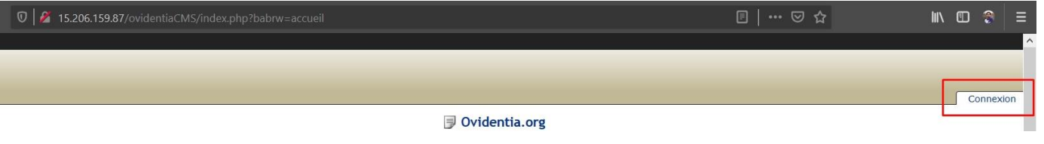
Observation
• Navigate to http://15.206.159.87/ovidentiaCMS/
• In the ovidentia CMS page there is option called Connexion to login as admin.

Slide 71
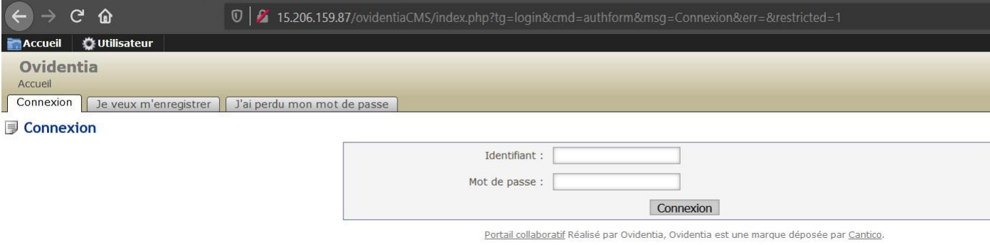
Observation

Slide 72
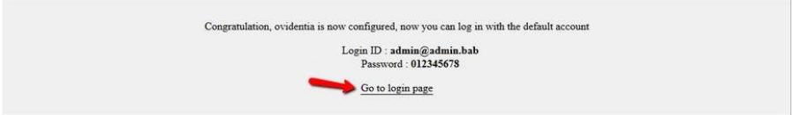
POC ADMIN ACCESS

Slide 73
Business Impact-Very High
Attacker can get Admin privileges

Slide 74
Recommendation
• Two- Factor Authentication for sensitive data should be added with strong passwords.
• Disable the default debug pages.
• Hide the admin login page.
• Remove all the default passwords and add your own password which should be very strong.

Slide 75
Refrences
https://hdivsecurity.com/owasp-security-misconfiguration

Slide 76
9)Descriptive Error Messages
Below mentioned URLs shows descriptive error messages,
Affected URL:
• http://3.6.40.63/?includelang=lang/fr.php
Affected Parameter:
• includelang

Slide 77
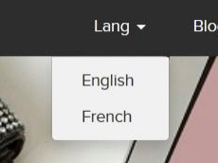
Observations
• Navigate to the website and click on change language dropdown, and select any of the two languages.

Slide 78
Observation
• Now, notice the URL, you get a ‘get’ parameter of includelang which shows descriptive error
messages.
• Here, we enter the payload: includelang=lifestyle and on executing this file the page throws a
descriptive error.

Slide 79
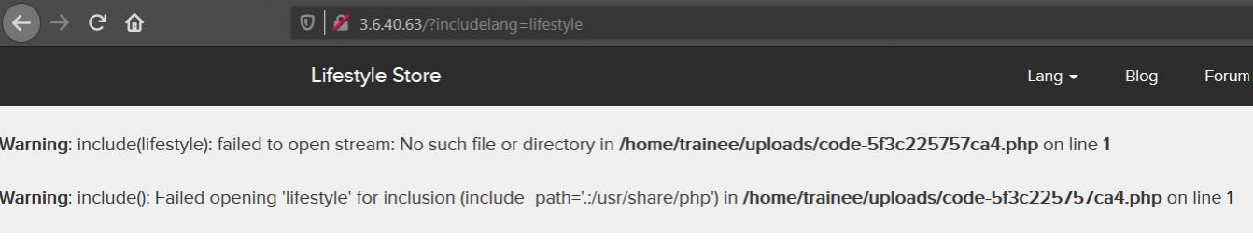
POC

Slide 80
Business Impact Low
• It doesn’t harm the website directly, but it is letting the hacker to know about the website architecture
which the hacker can to dig out internal resources and use them against the organization.

Slide 81
Recommendation
• Developers should turn off this descriptive error messages before the web application is finally released for general public use.

Slide 82
Refrences
https://owasp.org/www-community/Improper_Error_Handling

Slide 83
10)Default Files and Pages
Below mentioned URLs shows default files and pages,
Affected URL:
• http://3.6.40.63/
Default files and pages present:
• server-status
• robots.txt
• userlist.txt
• phpinfo.php
• composer.json

Slide 84
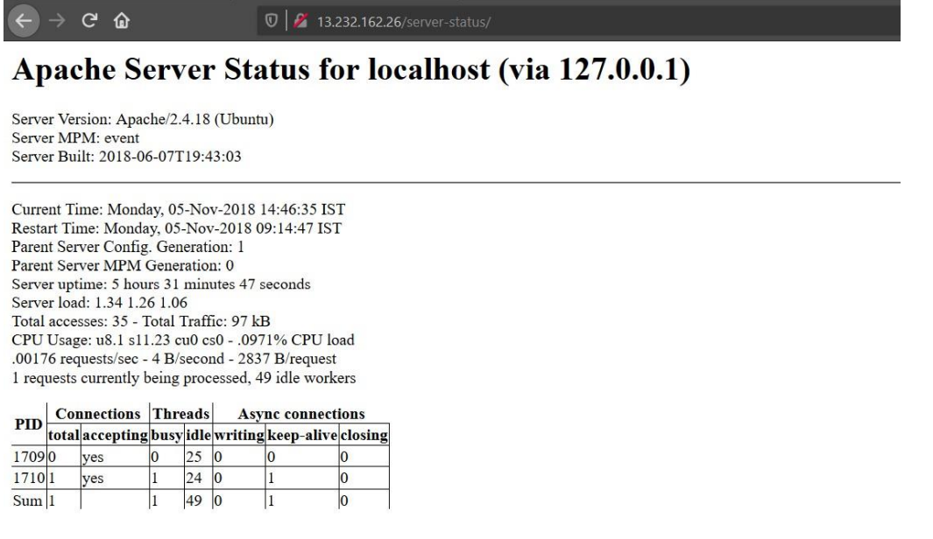
POC

Slide 85
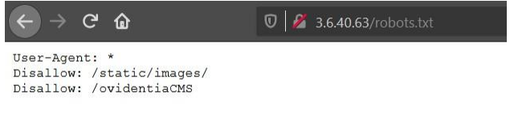
POC
Robots.txt

Slide 86
Business Impact Low
It doesn’t harm the website directly, but it is letting the hacker collect more internal information about the website which the hacker might use against the organization.

Slide 87
Recommendation
Developers should disable all default files and pages to be displayed publicly

Slide 88
Refrences
https://www.indusface.com/blog/owasp-security-misconfiguration/

Slide 89
11) Local File Inclusion
Below mentioned URL is vulnerable to LFI.
Affected URL :
• http://52.66.88.120/?includelang=lang/fr.php
Affected Parameters :
• /etc/passwd (/?includelang=here)
• https://www.google.co.in/ (/?includelang=here)

Slide 90
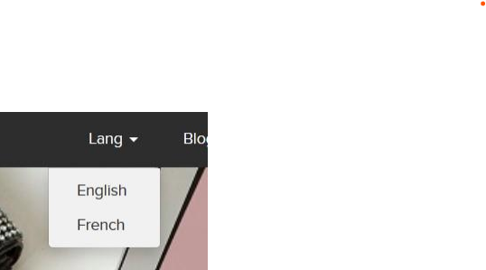
Observations
• Navigate to the website and click on change language dropdown, and select any of the two languages.

Slide 91
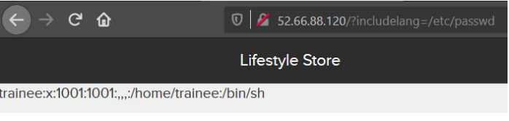
Observation
• Now, notice the URL, you get a ‘get’ parameter of includelang which is vulnerable to file inclusion.
• Here, we enter the payload: includelang=/etc/passwd and on executing this file gives us the username.

Slide 92
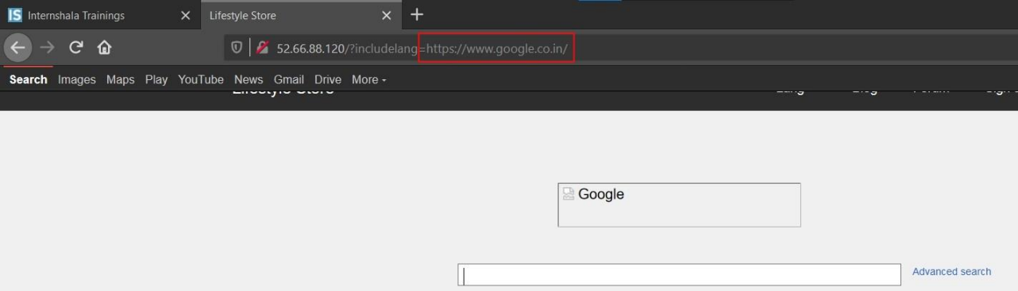
POC – Attacker can upload file

Slide 93
Business Impact Really High
• Any attacker can have the root access of your website.
• He can execute commands.

Slide 94
Recommendation
• To safely parse user-supplied filenames it’s much better to maintain a whitelist of acceptable filenames.

Slide 95
Refrences
https://www.invicti.com/blog/web-security/local-file-inclusion-vulnerability/

Slide 96
12)Directory Listing
Below mentioned URL leaks critical information via directory listing vulnerability.
Affected URL:
• http://13.232.162.26/static/images/uploads/products/reebok.jpeg
Here are other similar URLs that leaks critical information via directory listing
vulnerability.
Affected URL:
• http://13.232.162.26/robots.txt

Slide 97
Observation
• Navigate to http://13.232.162.26/products.php
• Now, right click on the image of any product and then select View Image or you can even drag the image to a new
tab.
• The page loads up as shown below, with the image of the selected product.\
• Notice the URL, it actually reveals the full path of the image.

Slide 98
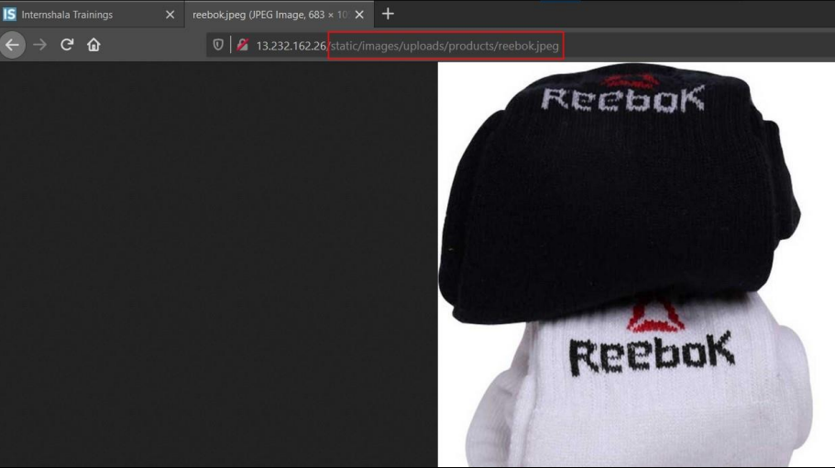
Observation

Slide 99
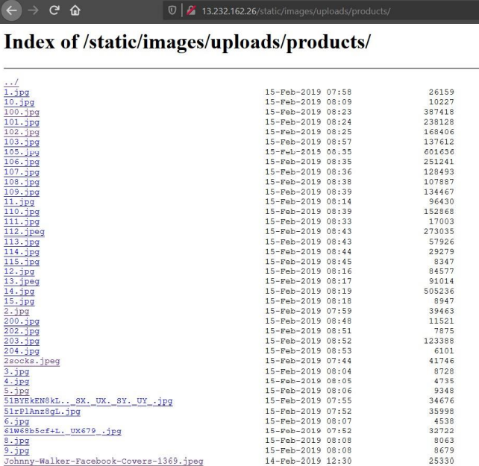
POC- Directory Listing
• Now, if we remove the image name (here, reebok.jpeg) and hit enter.

Slide 100
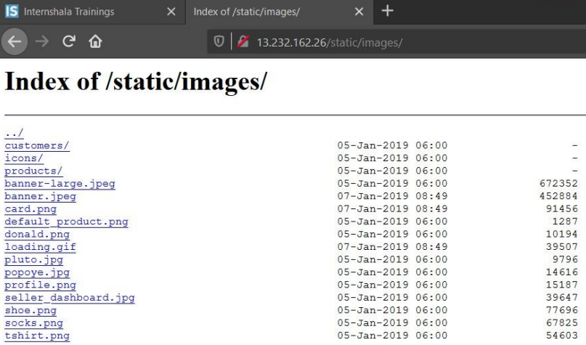
POC
• Navigate to http://13.232.162.26/static/images/

Slide 101
Business Imapact High
It can aid the attacker with information about the server and the users.

Slide 102
Recommendation
• Two- Factor Authentication for sensitive data should be added with strong passwords.
• Disable Directory Listing .

Slide 103
Refrences
https://www.invicti.com/blog/web-security/disable-directory-listing-web-servers/

Slide 104
13) PII leakage
Below mentioned URL is vulnerable to personnel identifiable information leakage.
Affected URL :
• http://3.6.40.63/profile/16/edit/

Slide 105
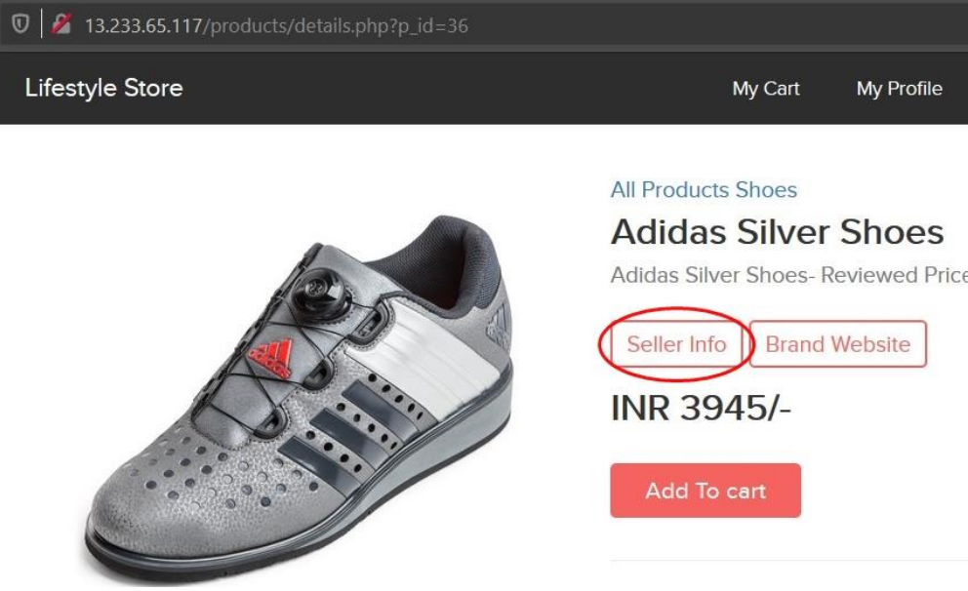
Observation
• Login to your account and go to Products page.
• In every product page the Seller Info is available

Slide 106
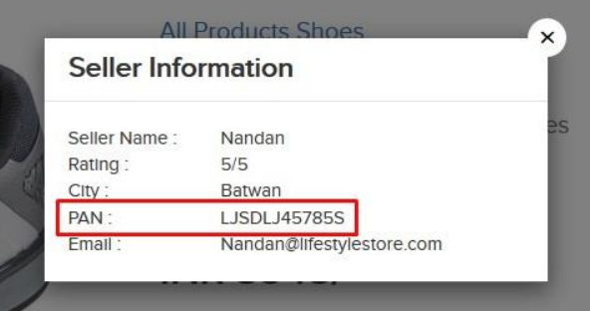
POC
Seller Name, Rating, City, Email along with PAN Card Details are shown

Slide 107
Business Impact High
• Leaking critical information like PAN Card details to everyone is highly vulnerable as, hackers can use such information to socially hack them

Slide 108
Recommendation
• Hide critical information like the PAN Card details.
• Display only minimal required information about the sellers

Slide 109
Refrences
https://www.imperva.com/learn/data-security/personally-identifiable-information-pii/

Slide 110
14)Open Redirection
Below mentioned URL is vulnerable to open redirection.
Affected URL :
• http://13.233.65.117/redirect.php?url=www.radhikafancystore.com
Affected Parameters :
• url

Slide 111
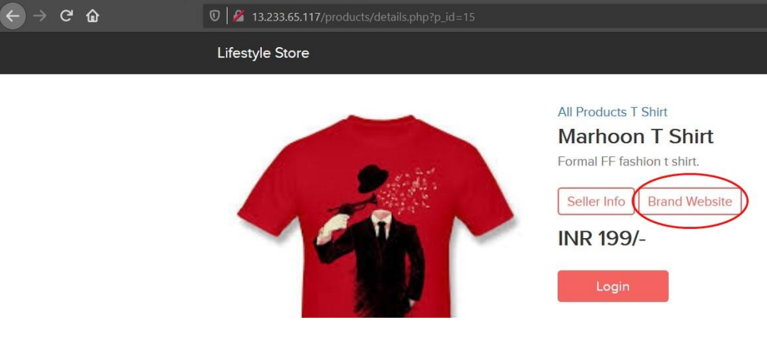
Observation
• Login to your account and go to Products page.
• In every product page the Brand Website is available, click on it.

Slide 112
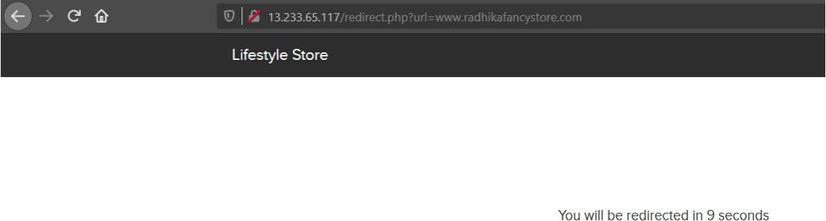
Observation
• Upon clicking on Brand Website, we are then being redirected to the brand’s website.

Slide 113

Observation
• Now, change the url from the brand website to some other website, here we use https://www.google.co.in/ and hit enter.

Slide 114

POC
Redirected

Slide 115
Business Impact High
Hacker can redirect to a malicious website

Slide 116
Recommendation
• Check your Referrers

Slide 117
Refrences
https://www.invicti.com/blog/web-security/open-redirection-vulnerability-information-prevention/

Slide 118
15) BRUTE FORCE EXPLOITATION
Below mentioned URL is vulnerable to brute forcing and can be exploited for discounts.
Affected URL :
• http://15.207.106.113/cart/apply_coupon.php

Slide 119

Observation
• Type in UL_6666 in the apply coupon section and intercept the request using Burp Suite

Slide 120

Observation
Use Burpsuite

Slide 121

Observation
WE brute force all possible combination of 4 digits
UL_1247 is valid coupon code

Slide 122

POC

Slide 123
BUSINESS IMPACT SEVERE
• Attacker can easily order the items on extreme discounts which in turn will cause huge loss to the company.

Slide 124
Recommendation
• Coupon codes should have limited number of uses and should be regenerated after sometime.
• Coupon code should be random alpha-numeric characters.

Slide 125
Refrences
https://www.digitalcommerce360.com/2017/03/17/prevent-fraud-brute-force-online-coupon-gift-card-attacks/

Slide 126
16)FORCED BROWSING
Below mentioned URLs is vulnerable to forced browsing.
Affected URL :
http://13.233.24.9/
Forced URLs :
• http://13.233.65.117/admin31/dashboard.php
• http://13.127.150.195/admin31/console.php

Slide 127
Observation
• As a customer, Login to your account.
• Now, forcefully type in the url for going to the admin dashboard http://13.233.65.117/admin31/dashboard.php

Slide 128

POC
ADMIN ACCESS

Slide 129
Business Impact Severe
• Attacker can have all the admin privileges.
• He can edit all the items.

Slide 130
Recommendation
• Server side security checks should be performed perfectly.

Slide 131
Refrences
https://owasp.org/www-community/attacks/Forced_browsing

Slide 132
17)Seller Account Access
Below mentioned URL shows the seller accounts and passwords.
Affected URL :
• http://15.206.159.87/userlist.txt

Slide 133

Observation
• Navigate to the website, at the homepage add /userlist.txt after the URL, the following page is opened.

Slide 134

POC
Attacker has seller account access

Slide 135

POC
Seller dashboard access

Slide 136
Business Impact Extremely High
Attacker can access the seller dashboard and then can edit the product’s name, image, and even the price of the products he/she is selling

Slide 137
Recommendation
The developer should disable these confidential default pages which reveals the username and password of the sellers.

Slide 138
Refrences
https://www.indusface.com/blog/owasp-security-misconfiguration/

Slide 139
THANK YOU
FOR FURTHER ASSISTANCE CONTACT
Email- sourabhpradhan44@gmail.com

